Slide 1

“Regional Gas Market Integration Italy-Austria“
online
GRI SSE
30.10.2020
Alessandro Ischia
E-Control

Slide 2
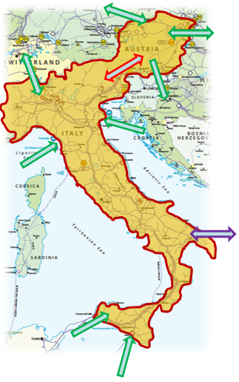
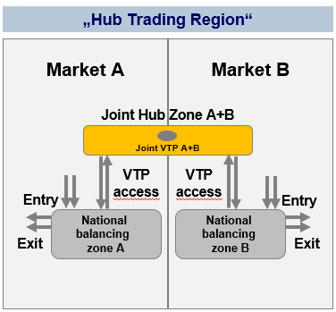
Marktintegration AT-IT
Two markets can gain wholesale market volumes and better efficiency by combining their demand and supply volumes into a single wholesale market
„Hub Trading Region“
- Bookable points between currently
national market zones (IP Tarvisio/ Arnoldstein) to disappear
- Inter TSO compensation
- Remaining network points form the integrated entry/exit system
- New marginal price for commodity

Slide 3


Study on price formation
ARERA and E-Control decided to tender a study regarding the Italian-Austrian wholesale price formation in order to identify the marginal route of the two market areas separated and in the light the integration

Slide 4
Goal
Explain the price formation in the Austria and Italy market areas
Quantify the effect of the market merger on the price formation with a model-based analysis
The study is not a cost-benefit-analysis of the market zone merger, but rather an analysis of distributional effects through price changes
  Important to deepen the results of a first analysis (simplified CBA) executed in 2016 concerning distributional effects of wholesale price formation
  Crucial for assessing the need for compensation mechanisms in case of realizing such a market integration

Slide 5
Key drivers / assumptions
A comparison of historic prices suggests that in many situations it is largely one marginal source of gas influencing the price in several EU regions
price differences across market areas are mainly driven by transportation costs
suppliers adjust their supply prices according to this reference price, net of the transportation costs to reach the supplied region (net back pricing logic)
“take or pay” clause: while the producer therefore traditionally took the “price risk”, it was the importer or down streamer, who took the “volume risk”

Slide 6
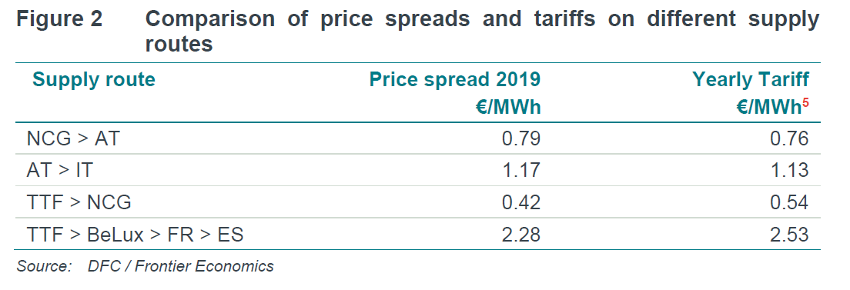
Comparison of price and tariffs on different supply routes

Slide 7
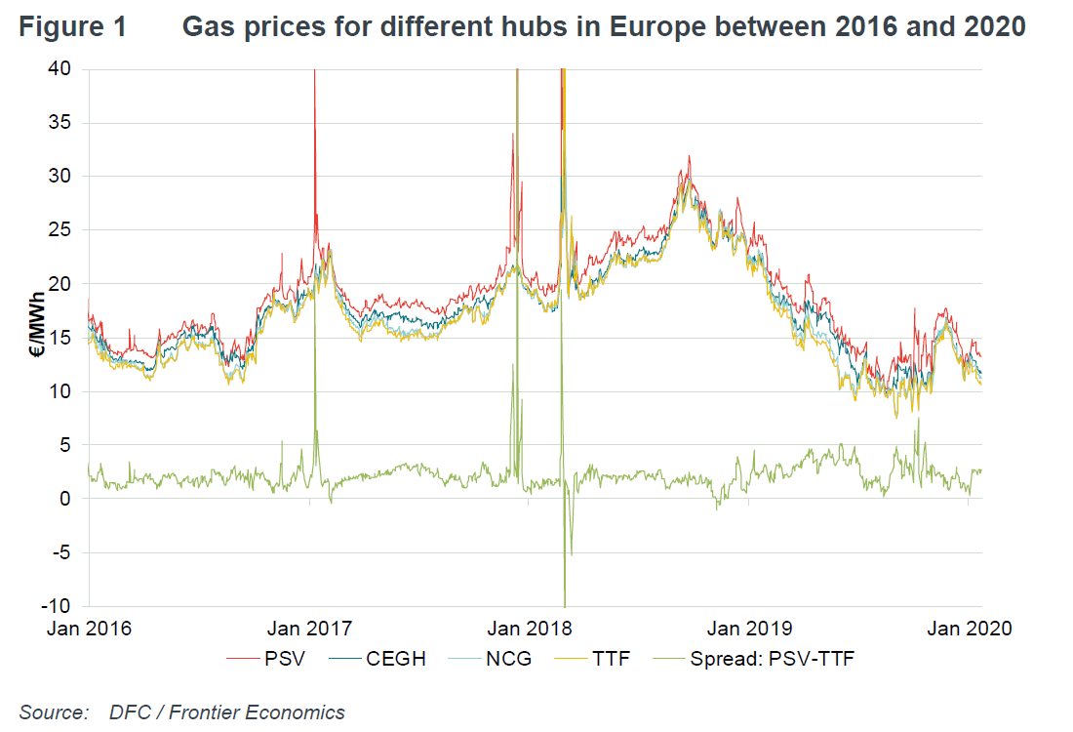

Slide 8
Key drivers / assumptions
But….
intertemporal components of the price formation are still significant drivers of short-term price volatility:
  availability of storage and transport capacity
  variable costs (tariffs) for storage and transport capacity usage;
  contractual obligations (e.g. take-or-pay commitments)
  fundamental changes to the supply/demand ratio (e.g. driven by weather effects, economic developments as e.g. currently seen in relation to the Corona-Pandemic, …)
  changes in the opportunity cost of gas for the market participants.
  changes in direct supply cost.
short-term price volatility, being to a large degree related to fluctuating events, is not captured in a long-term simulation approach

Slide 9
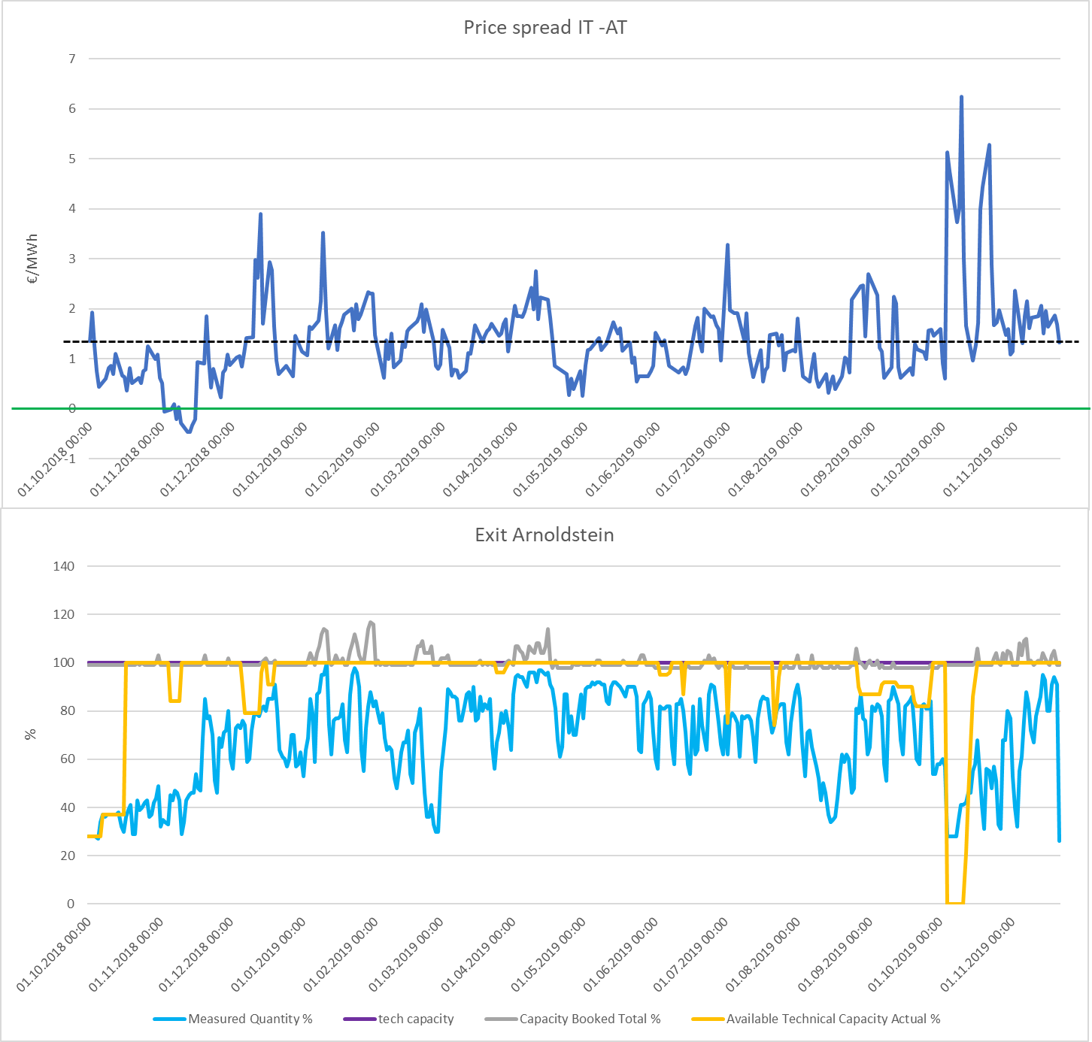
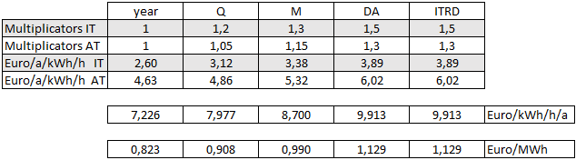
short-term price volatility
AT cheaper
IT cheaper

Slide 10
Modelling Approach
Supply mix is about to change but LNG likely to remain a marginal supply source
Demand may decline reducing congestion in the European network
Long-term capacity bookings are expected to expire
The gas market model is a least-cost dispatch model, which minimises supply costs for the entire European area by choosing optimal supply routes
Modelled years 2020, 2025 and 2030
Price formation based on a single reference price for Europe and net back logic for all other suppliers

Slide 11
Contraints for each temporal units
The following constraints are added to the model:
Energy balance. For each country, the net sum of inflows and outflows must be equal to the consumption
Transportation capacity. For each interconnection, the gas flow cannot exceed a given capacity
Storage capacity. For each month and storage facility, the stored gas cannot exceed a certain level
Storage cycle. Over the storage year (April – March), no gas can be left into storage
Supply constraints. For each supplier other than LNG, the exported gas volume must not exceed a given level

Slide 12
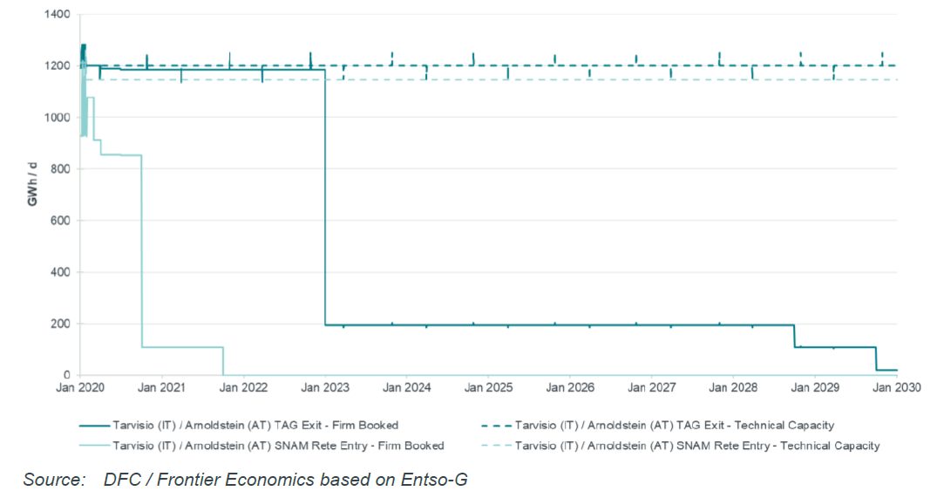
Tarvisio / Arnoldstein capacity bookings

Slide 13
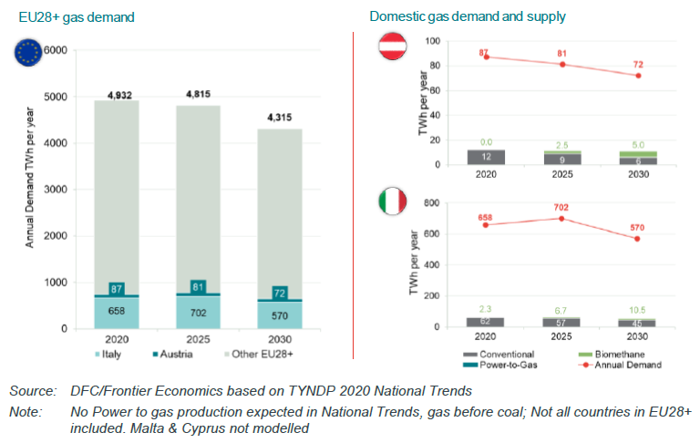
Gas demand and indigenous production

Slide 14
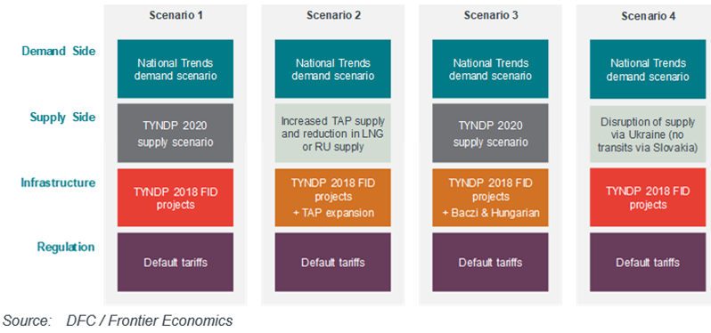
Scenarios analysed

Slide 15
Market integration AT-IT - results
It can be assumed that LNG is marginal supplier at European level.
The effects of the market zone merger are quantified based on a model with fixed supply volumes where market and supply prices are derived on a net-back-logic to the marginal gas price to Europe (LNG)
The model minimises gas transport and gas storage costs
The missing tariff income (from IP Arnoldstein Tarvisio) is recovered by increasing exit tariffs to end customers.
The market zone merger makes gas flows from Austria to Italy cheaper. As a result gas flows on this route increase.
  the additional gas flows are sourced indirectly from Germany (via the Czech Republic and Slovakia)
  they replace gas supply to Italy from Switzerland and from LNG.
Gas market price in Austria and Italy to align as a result of the merger. This happens by Austrian prices generally increasing and/or Italian prices decreasing.
While for 2020 we find that price are only reduced in Italy to the level of Austrian prices, the results for 2025 and 2030 show a mixed picture of price increase in Austria and price reduction in Italy

Slide 16
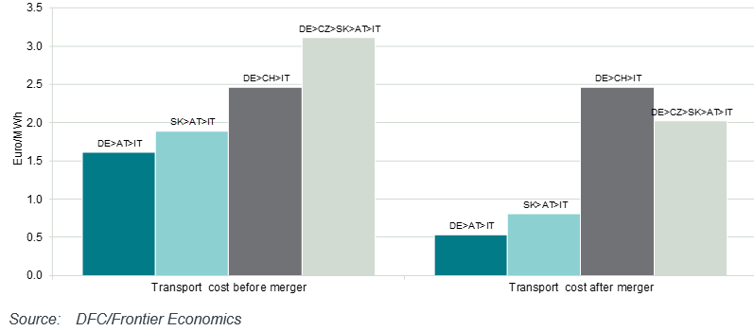
Market integration AT-IT - Study on Marginal price/route
Change in regional annual gas flows
AT>IT
AT>IT
AT>IT

Slide 17
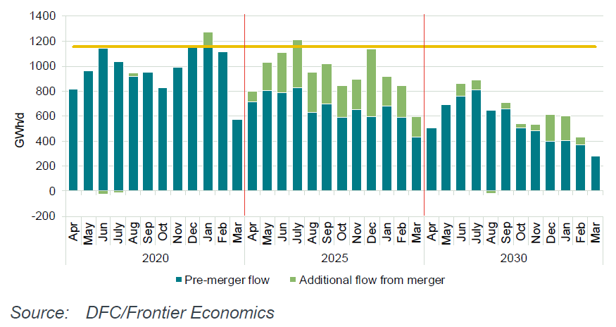
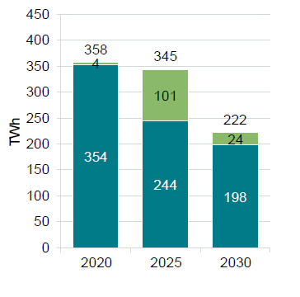
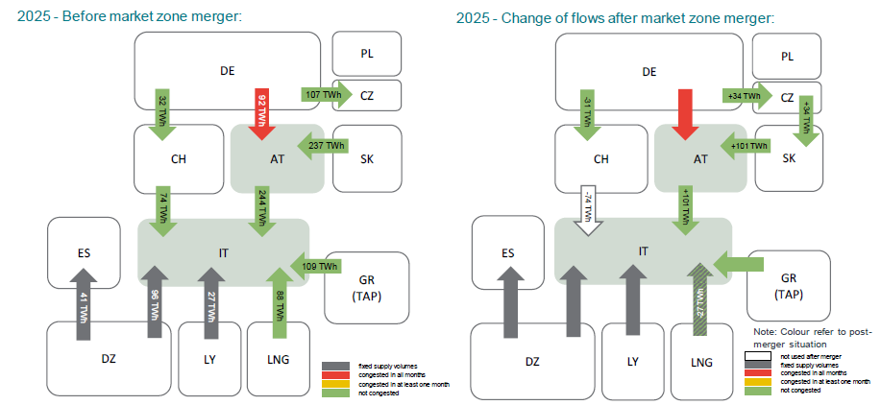
Results Base scenario
Flows on the Tarvisio-Arnoldstein Pipeline before and after the market zone merger

Slide 18
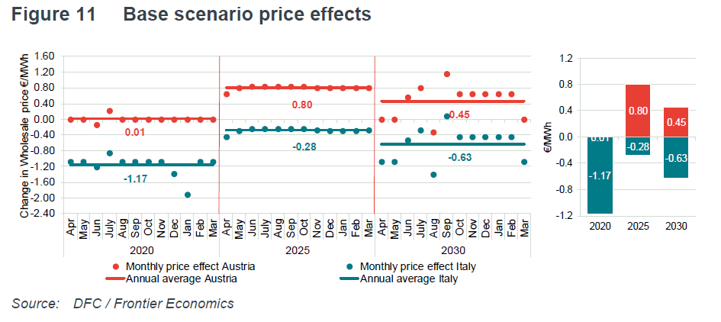
Results Base scenario

Slide 19
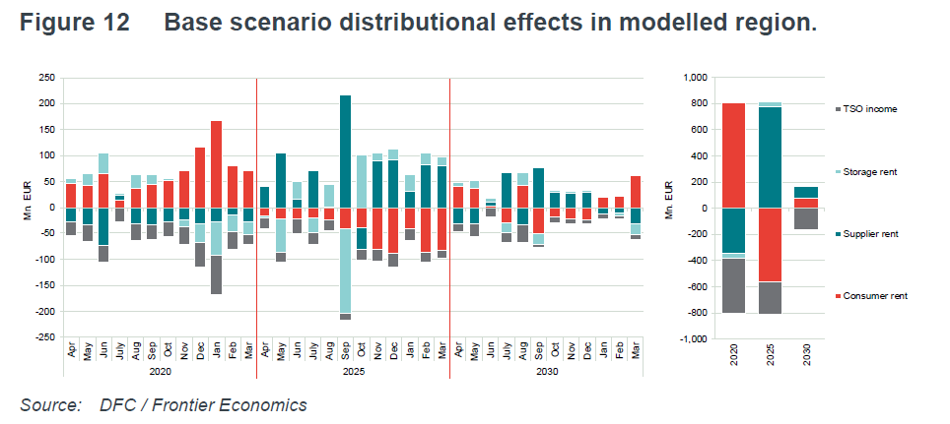
Results Base scenario

Slide 20
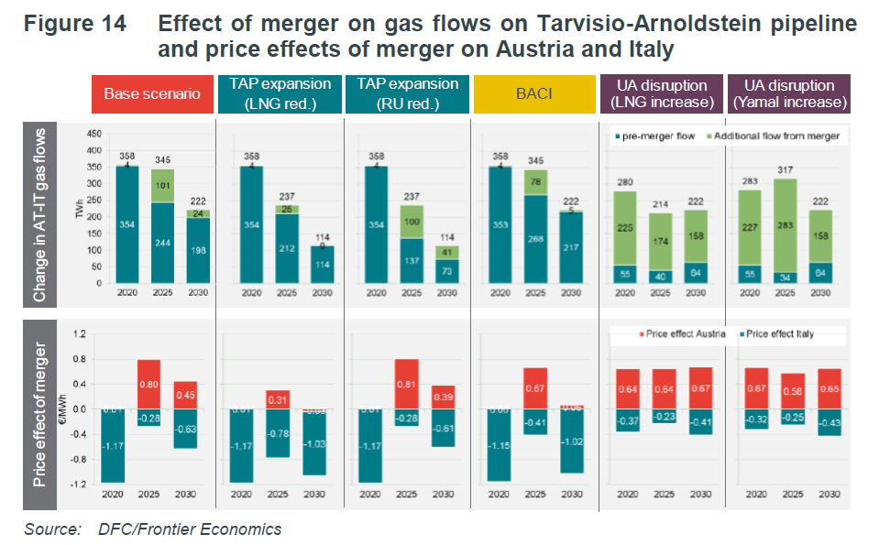
Results alternative scenarions

Slide 21
Next steps
Publication of the report
Analysis of the results after TAP pipeline will come online
Potential additional analysis considering the base scenario with TAP

Slide 22
Mr. Alessandro Ischia
Tel: +43124724810
E-mail alessandro.ischia@e-control.at

Slide 23
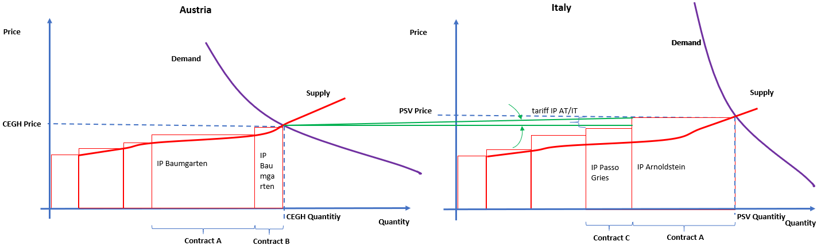
Marginal Route Analysis

Slide 24
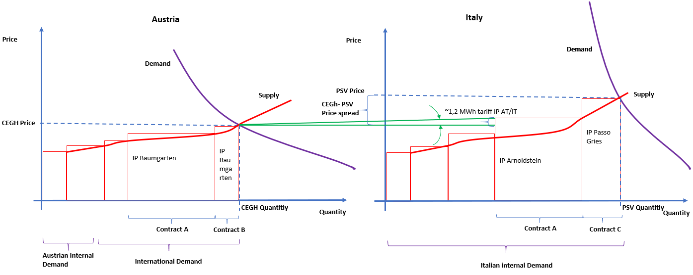
Marginal Route Analysis

Slide 25
Way forward
Status Quo
Decision to start detail concept preparation
Joint implementation decision
Identiying
the need
for action
Preliminary view on
concept fundamentals
Preparation of a concrete/detailed implementation
concept
Cost/benefit analysis
Implement-ation
Current stage – with the objective to:
develop early on the basic principles of the concept
allow at an early stage the decision whether the preparation of a detailed concept (with subsequent CBA) should start
However, without prejudice to any implementation decision

